Slide 1
Open Event Schemas
Niranjan Balasubramanian
University of Washington

Slide 2


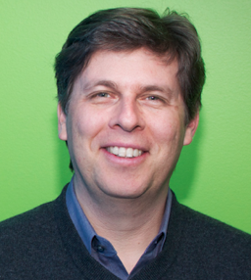
Collaborators
Stephen Soderland
University of Washington
Mausam
Indian Institute of Technology, Delhi
Oren Etzioni
Director
Allen Institute of Artificial Intelligence (AI2)

Slide 3
Information Overload
Not much needs to be said.
Notes:
The slide says it all.
If you believe you are not overloaded with information. All I have to say is good for you!

Slide 4
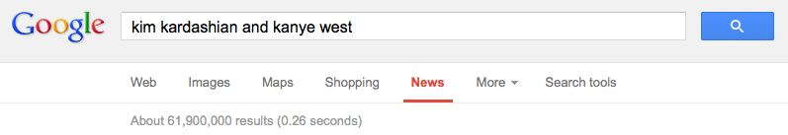
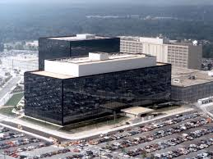

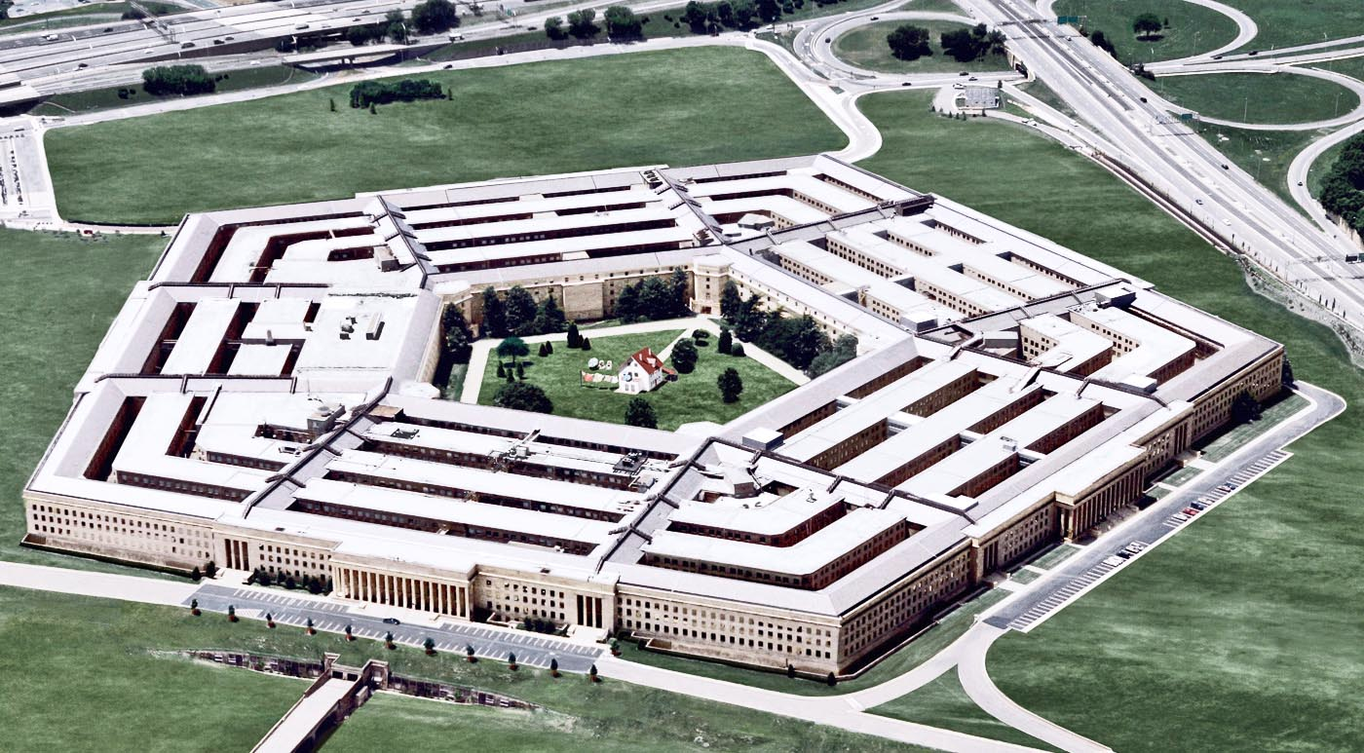
Ten blue links doesn’t cut it anymore!
~ 62 Million documents is a bit much for even the most ardent fan!
Users with small devices and comparable attention spans!
Analysts poring over data to find important connections.
Notes:
There are people for whom the ten blue links doesn’t cut it anymore.
More content gets generated today than ever.
if you are an intelligence analyst, or a research analyst at a firm, monitoring news feeds for intelligence is overwhelming to say the least.
generating summaries and being able to answer questions are both attractive from a research standpoint as well as from apps – think Siri, Summly.

Slide 5
Retrieval to Machine Reading
Information extraction to the rescue!
Notes:
There is a paradigm shift in information access – from retrieval to reading.
Here is where information extraction is playing an increasingly important role.

Slide 6
Information Extraction
Unstructured
Text
Extractor
Structured
Semi-structured
Notes:
So what is information extraction.
A function from text to a structured or semi-structured database.

Slide 7
Entity Extraction
People
Places
Text
Extractor
Organizations
Notes:
Well studied problem.
Several successful systems and products exist.
Mostly supervised methods.

Slide 8
Relation Extraction
employed by
acquired by
Text
Extractor
president of
Several on-going research efforts!
Notes:
Several on-going research efforts.
NELL at CMU
PATTY at Max Planck
Open IE extractors from UW
Universal Schema from UMass

Slide 9
Schema-based Extraction
Arson
Arrests
Unstructured
Bombing
News articles
Extractor
Lawsuits
defendant
plaintiff
judge
Well studied problem.
Focus has been on extraction using manually generated schemas.
Structured
Semi-structured

Slide 10
Context
Relation extraction → Open Relation Extraction
Schema extraction → Open Schema Extraction

Slide 11
Bottlenecks in relation extraction
employed by
Extractors learned for each relation from labeled training examples.
[Kim and Moldovan, 1993]
[Riloff, 1996]
[Soderland, 1999]
acquired by
president of

Slide 12
Bottlenecks in relation extraction
How many such relations exist?
Where do these relations come from?
How to obtain necessary resources?
Can these operate at web scale?
employed by
acquired by
president of

Slide 13
Open Information Extraction
Domain independence
Training for each domain/relation is not feasible.
Coherence
Readability is important for human interaction.
Scalability
Need to process enormous number of documents.
[Etzioni et al., 2003], [Banko et al., 2007], [Fader et al., 2011]

Slide 14
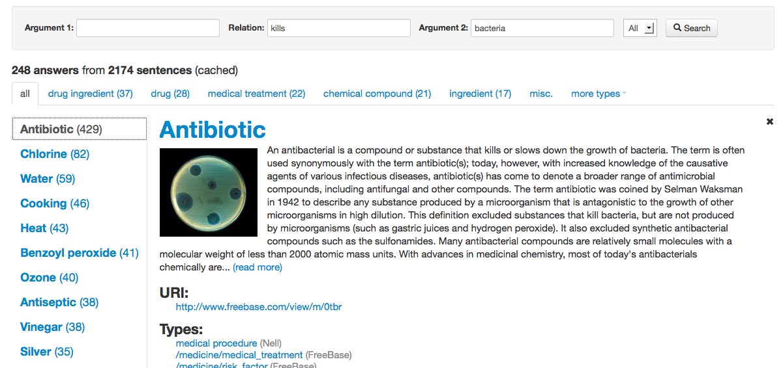
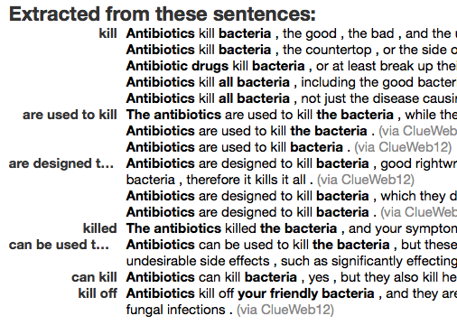
Open Information Extraction
Extracting information from natural language text
for all relations in all domains in a few passes.

Slide 15
Open Event Schemas
How many such schemas exist?
Where do these schemas come from?
How to obtain necessary resources?
Can these operate at web scale?
Arson
Arrests
Bombing
Lawsuits
defendant
plaintiff
judge

Slide 16
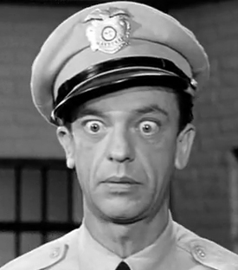


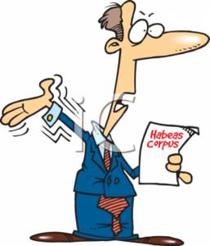
Event Schemas
Example
A set of actors and the roles they participate in.
arrest
charge
sentence
represent

Slide 17
Event Schemas
A set of actors and the roles they participate in.
Actor
Relation
Actor
Police
FBI
…
A1
arrest
charge
A2
John Gotti
man
…
Judge
US District Judge
…
A3
sentence
A2
Ben Coates Attorney Morgan
…
A4
represent
A2
Notes:
List of (Actor, Relation, Actor) tuples.
Numbered actors (instead of labels).
Roles represented via relations.
(Typed) Instances from which we can gather some semantics about the actor.

Slide 18
Applications
Templates for information extraction
[Patwardhan and Riloff, EMNLP 2009]
As world-knowledge for co-reference
[Irwin et al, CoNLL 2011]
Summarization
[TAC Summarization, 2010]
Notes:
Fernando Pereira alluded to a similar idea.

Slide 19
Outline
Prior work
Coherence issues
Our approach
Representation
Rel-grams
Finding related tuples
Building schemas
Evaluation
Mechanical Turk
Balasubramanian et al., EMNLP 2013 and AKBC-WEKEX 2012

Slide 20
Prior Work
Manually authored e.g.. MUC Templates
Laborious
Limited domains.
Automatically induced from text.
Narrative schemas [Chambers and Jurafsky, 2009]
Event templates [C & J, 2011] and [Chambers, 2013]
Probabilistic Frames [Cheung et al., 2013]
Notes:
Chambers and Jurafsky in their seminal work showed an automatic method.
Chambers
and one other recent work has followed up with probabilistic induction

Slide 21

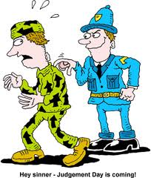
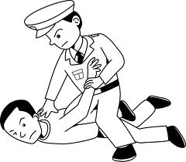
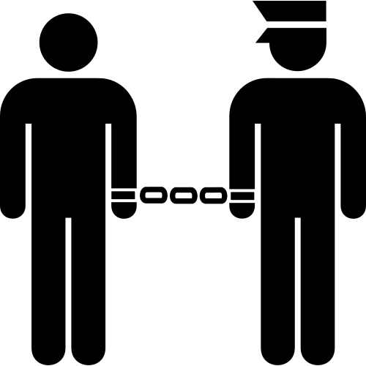
Narrative Schemas
Notes:
Go from large number of news articles – see enough number of arrests – figure out who the key actors are and the roles they play.

Slide 22
Narrative Schemas
Method:
Extract (subj-verb) and (verb-obj) pairs that have a co-referrent entity.
Compute PMI for pairs based on co-occurrence.
For each verb, cluster the top dependency pairs using a greedy algorithm
Pros:
Fully automatic
Scales to arbitrary domains
Cons:
Coherence issues!
Notes:
Extract subj, verb and verb-obj dependency pairs

Slide 23
Mixing Distinct Events
Actor
Relation
Actor
infection
fire
A1
A2
disease
caused
disease
A2
A1
infection
fire
spread
infection
fire
A1
broke out
extinguished
A1
infection
fire

Slide 24
Mixing Distinct Events
Why?
disease
broke out
in … and
spread
very quickly…
S1, S2
V1
V2
(x, broke out)
(x, spread)
fire
broke out
in … and
spread
quickly to…
S1, S2
V1
V2
(x, broke out)
(x, spread)
Notes:
Table on the left shows a schema that mixes two events – disease spreading and fire spreading.
other:
airlines scheduling flights,
government scheduling meetings,
nba, scheduling games

Slide 25
Mixing Distinct Actors
Actor
Relation
Actor
house
president
bill
A1
A2
bill
measure
law
pass
house
president
bill
A1
A2
sign
Why?
Number of actors guided by a splitting parameter in clustering.
Restrictive settings can cause conflation.

Slide 26
Our Solution
Relation triples based representation
(Arg1, Relation, Arg2)
disease
broke out in
[location]
spread to
[person]
Arg1
Relation 1
Arg2
Relation 2
Arg2
fire
broke out in
[structure]
spread to
[structure]
Arg1
Relation 1
Arg2
Relation 2
Arg2
More specific representation reduces ambiguity.
Semantic classes improve actor coherence.
Notes:
We propose to relation triples as representation.
This has

Slide 27
Outline
Prior work
Coherence issues
Our approach
Representation
Modeling relation co-occurrence
Finding related tuples
Building schemas
Evaluation
Mechanical Turk

Slide 28
Approach
Use Open IE relations to represent events
Construct a model of relation co-occurrence
Find tuples related to an event using graph analysis.
Build schemas from related tuples.
Notes:
Our approach largely follows Chambers’ idea.

Slide 29
Representation
Open IE relations to represent events
Scales easily to arbitrary domains.
Relation triples are more specific than dependency pairs
More expressive (Verb + Preposition)
Semantic classes as arguments
Addresses sparsity
Improves actor coherence

Slide 30
Generalized Tuples
Extract tuples using Ollie, an Open IE system.
(Arg1, Relation, Arg2) format.
Normalize relation strings
Stem, remove modifiers.
Extract lexical heads for arguments
Assign classes to argument heads
29 semantic types from WordNet
Text: “He cited a new study that was released by UCLA in 2008.”
Tuples:
1. (He, cited, a new study)
2. (a new study, was released by, UCLA)
3. (a new study, was released in, 2008)
Generalized Tuples:
T1. (He, cite, study)
T2. (He, cite,[activity])
T3. ([person], cite, study)
T4. ([person], cite,[activity])
T5. (study, be release by, UCLA)
T6. (study, be release by,[org])
T7. (study, be release in, 2008)
T8. (study, be release in,[timeunit])
T9. ([activity], be release by, UCLA)

Slide 31
Rel-grams Model
A model of co-occurrence between relations.
Delta smoothed conditional probabilities
Estimates for different co-occurrence windows combined
Estimated from large corpus (1.8 M NYT)

Slide 32
Rel-grams Tabulation
Extract generalized tuples from documents.
Identify co-referring arguments in tuples.
Arguments with co-referring entities.
e.g.. T5. (study, be release by, UCLA)
T6. (study, be release in, 2008)
Tabulate tuple co-occurrence counts
within various window sizes 1 – 50.
Record equality counts for arguments.
Database with 320 K tuples with 1.1M Rel-grams.

Slide 33
Rel-grams Evaluation
Do Rel-grams capture meaningful associations?
Are tuples T and T’ valid?
Well formed and make sense in the real world.
Textual entailment guideline:
T => T’ or T’ => T
Topic(T) = Topic(T’)

Slide 34
Rel-grams Evaluation
Selected 12,600 seed tuples
Top 10% of tuples with at least 25 Rel-grams
Evaluated a sample of the 280K Rel-grams
Results:
87% of seed tuples were valid.
74% of the Rel-grams had both tuples valid.
83% of the valid tuples were an implication.
90% of the valid tuples were on common topic.
Notes:
Tuple validity is a problem:
Open IE is about 75% accurate.
Rel-gram let’s the errors multiply!
Strong implication results show there is a signal here.

Slide 35
Outline
Prior work
Coherence issues
Our approach
Representation
Modeling relation co-occurrence
Finding related tuples
Building schemas
Evaluation
Mechanical Turk

Slide 36
Finding tuples related to events
1. Create a graph of relations (Rel-graph)
2. Identify seed tuples to build schemas.
3. Analyze seed neighborhood to find related tuples.

Slide 37
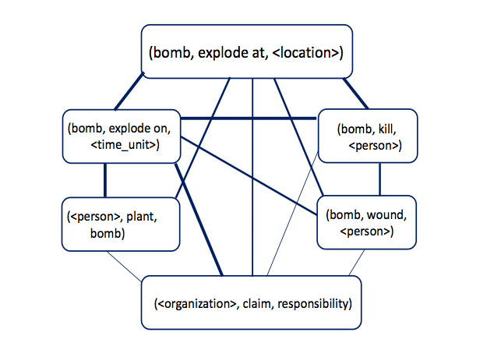
Rel-graph
Tuples as nodes.
Weighted edges
Symmetric conditional probability

Slide 38
Finding Seeds
High connectivity nodes are good seeds.
Sort nodes by the sum of top 50 SCP edges.

Slide 39
Extracting Neighborhood
For each seed:
Select the top neighbors up to two hops away.

Slide 40
Graph Analysis: Personalized Page Rank
Page Rank “personalized” to a query [Haveliwala, 2002]
Higher score for nodes with connections to
query
query’s neighbors

Slide 41
Personalized Page Rank
Higher score for nodes connected to query and query’s neighbors.
([person], use, [drug])
([person], use, [substance])
([person], suspended by, [org])
([person], suspended for, [time])
([person], fail, test)
([person], suspended for, [activity])
([person], be member of, [org])
([person], be member of, [org])
([person], be director of, [org])

Slide 42
Personalized Page Rank
Higher score for nodes connected to query and query’s neighbors.
([person], use, [drug])
([person], use, [substance])
([person], suspended by, [org])
([person], suspended for, [time])
([person], fail, test)
([person], suspended for, [activity])
([person], be member of, [org])
([person], be member of, [org])
([person], be director of, [org])

Slide 43
Outline
Prior work
Coherence issues
Our approach
Representation
Modeling relation co-occurrence
Finding related tuples
Building schemas
Evaluation
Mechanical Turk

Slide 44
Building Schemas
Collect actor candidates from arguments.
e.g. (A1:[person], suspended by, A2:[org])
(A3:[person], used, A4:[substance])
Use equality constraints to merge actors.
e.g., (A1:[person], suspended by, A2:[org])
(A1:[person], used, A4:[substance])
Merge actors that perform same roles
Do not merge actors with incompatible classes
Do not merge actors with a relation between them.
Output the top actors and the top K relations as the schema.

Slide 45
Example output
Actor
Relation
Actor
[person]
Murray,
Morgan,
Gov. Bush,
...
A1
A2
[none]
test
failed
A1
A3
[time]
season, week, month,,…
suspended for
A1
A4
[substance] [drug]
cocaine, drug, gasoline, …
used
A1
A5
[game] [activity]
violation, game, abuse, …
suspended for
A1
A6
[location]
desert, Simsbury, Albany, …
was in
A1
A7
[person] [organization]
Fitch, NBA, Bud Selig, …
suspended by

Slide 46
Outline
Prior work
Coherence issues
Our approach
Representation
Modeling relation co-occurrence
Finding related tuples
Building schemas
Evaluation
Mechanical Turk

Slide 47
Evaluation Goals
Topic coherence
Do the schema relations form a coherent topic?
Actor coherence
Do instances of an actor form a coherent set?

Slide 48
Mechanical Turk Evaluation
Schemas are complex artifacts
Actors with semantic classes + instances
Create simpler instantiations
Ground tuples in schema by sampling instances.
Estimate schema quality by evaluating instantiations.

Slide 49

Turker Tasks: Topic Coherence
Determine which grounded tuples are valid.
Do a majority belong to a single topic?
Which tuples do not belong?
Valid On Topic
Subject => Action => Object
bomb => explode in => city
bomb => explode kill => people
bomb => explode on => Friday
… => … => …

Slide 50
Turker Tasks: Actor Coherence
Do the instances have a common role?
Which instances do not fit role?
Has Role Fits Role
Subject => Action => Object
bomb => explode in => city
missile => explode in => city
grenade => explode in => city
Has Role Fits Role
Subject => Action => Object
missile => explode in => city
missile => explode in => neighborhood
missile => explode in => front

Slide 51
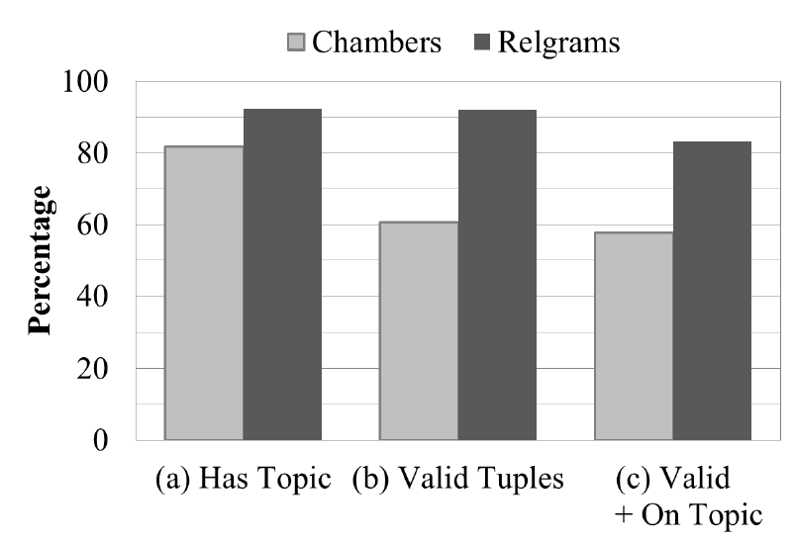
Results: Topic Coherence
Based on
500 instantiations
from 100 schemas.
Use of triples improves topical coherence.
Chambers’ schemas have more invalid tuples i.e., incoherent assertions.

Slide 52
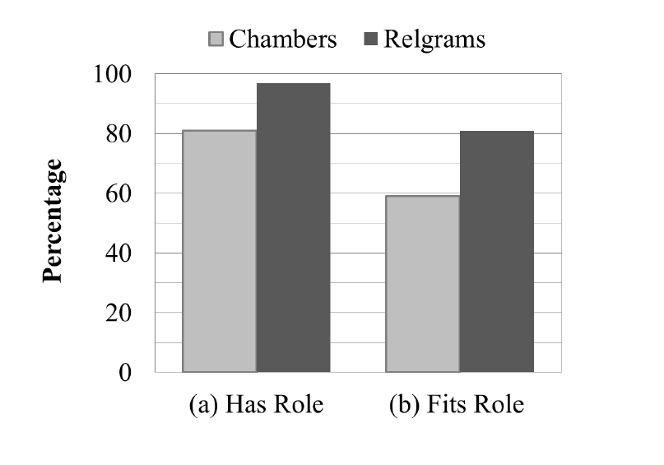
Results: Actor Coherence
Use of semantic classes improves actor coherence.
More actors are coherent sets
Fewer instances that do not fit role.

Slide 53
Comparison: Chambers
A1
oppose
sign
approve
veto
support
pass
A2
A1
A2
bill
president
house
A1
A2
bill
measure
legislation
A1
A2
A1
A2
A1
A2
Conflating actors:
bill, president, and house.

Slide 54
Comparison: Rel-grams
Carey
Anthony
Volpe
A1
veto
sign by
pass by
sign into
to sign
governor of
A2
legislation
bill
law
A2
A1
Sate senate
Senate
House
A2
A3
A1
A4
law
bill
A1
A5
Mass.
state
S. Carolina
A1
A6
Open IE provides nice benefits over SVO:
- Able to distinguish distinct actors.
- Noun mediated relations captured.

Slide 55
Errors
Extraction errors: truncating n-ary tuples
(Mr. Diehl, spend than, commissioner)
Mr. Diehl spends more time …. than the commissioner on …
Mismatched actors
(A1:[person], graduate from, A2:[org])
A2 = {James High School, church, …}

Slide 56
Summary
Addresses coherence issues in schema generation.
Developed Open IE based representation for events.
Graph analysis based approach for generating schemas.
Evaluation shows Rel-grams produce more coherent schemas.
Resources available for download.
Rel-grams and schemas.
http://relgrams.cs.washington.edu

Slide 57
Future Work
Enhancements to Schemas
Causality and temporal ordering.
Improving scope of semantic classes.
Addressing redundancy.
Applications
Building extractors for Open event schemas.
Co-reference
Single-document summarization

Slide 58
Open IE for QA
What knowledge is needed to pass 4th Grade science exam?
In collaboration with:
Allen Institute for Artificial Intelligence

Slide 59
Open IE for QA
Multiple-choice questions.
If an object is attracted to a magnet, the object is most likely made of
(A) wood (B) plastic (C) cardboard (D) metal
An object’s hardness, taste, and texture are examples of
(A) principles (B) stages (C) properties (D) processes
Growing thicker fur in the winter helps some animals to
(A) hide from danger (B) attract a mate (C) find food (D) keep warm
Which unit of measurement can be used to describe the length of a desk?
(A) centimeters (B) grams (C) liters (D) degrees Celsius
A decrease in air temperature from 60°F to 35°F would most likely cause a person to (A) shiver (B) sweat (C) blink his eyes (D) feel sleepy

Slide 60
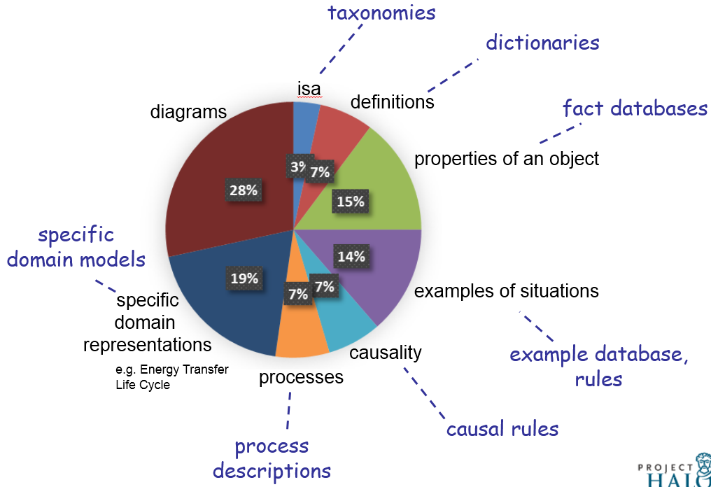
Open IE for 4th Grade Science Exams
[AKBC-WEKEX, 2013]

Slide 61
Open IE for Knowledge Acquisition
Object | Property
metal | conductor of electricity
metal | attracted to magnet
metal fork | made of metal
… | …
Instance | Class
turtle | animal
hardness | property
pumpkin | fruit
… | …

Slide 62
Open IE for Knowledge Acquisition
Action | Purpose
some animals grow thick fur | [some animals] stay warm
humans sweat | [humans] adjust to hot temperature
squirrel stores nuts | prepare for seasonal changes
… | …
Cause | Effect
decrease in temperature | shiver
… | …
Entity | Function
hand lens | look at small things
centimeters | measure length
sense of sound | hear sounds
… | …

Slide 63
System Overview
Question Interpretation
BOW
Solver
Tuple
Solver
MLN Solver
???
…
Study
guide
Web
Defns
Cause/Effect
Action/Purpose
Taxonomic
…
Open IE
Relation-specific

Slide 64
Questions?
Thank you.

